Slide 1
Water Supply, Infrastructure Planning & Impacts
By: Adriaan DeVilliers, PE
For: Board of County Commissioners & City Officials
Notes:
AdeV, a PE from Manatee cnty since 2013
Today I want to add to recent discussions on infrastructure and the effects of Storm Debbie & approaching Tropical depression 9, forecast to replicate Debbie this week

Slide 2
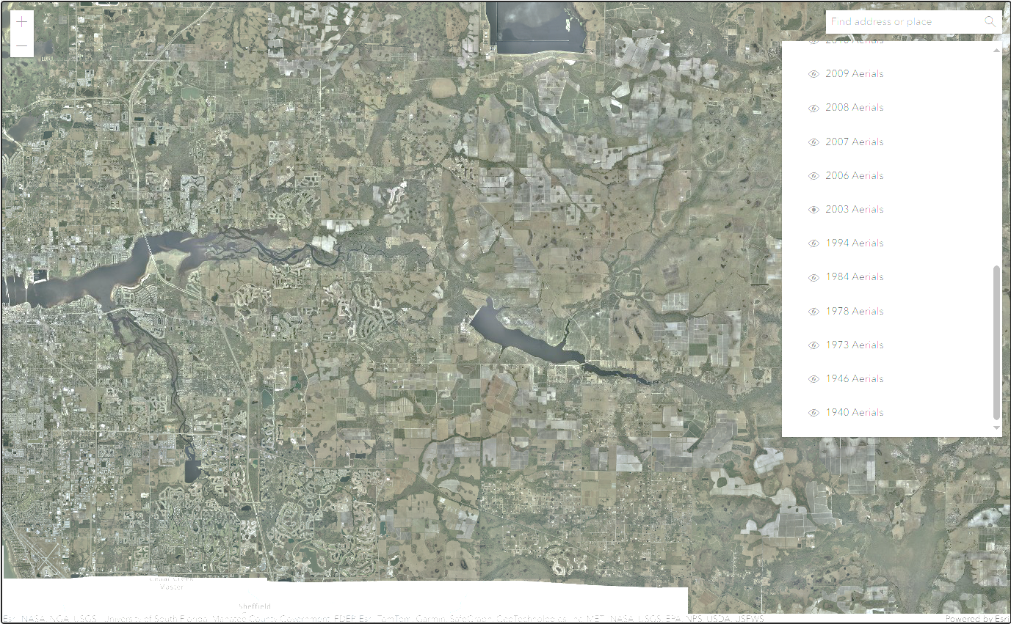
Manatee County E: 1994

Slide 3
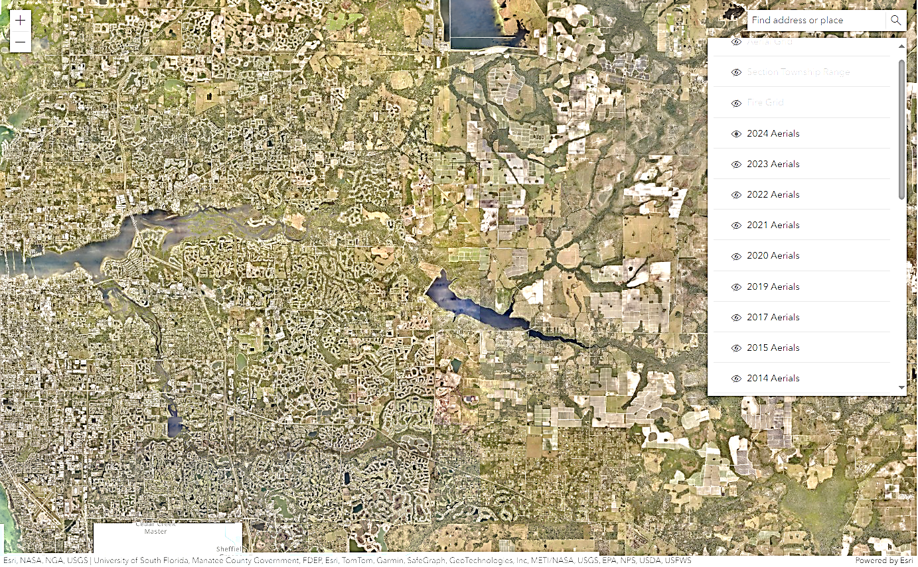
Manatee County E: 2024

Slide 4
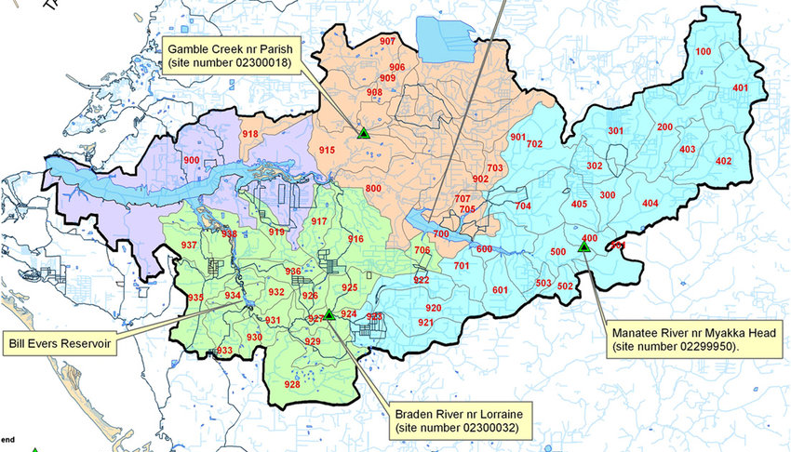
Lake Manatee & Sub-Catchment Areas - USGS

Slide 5
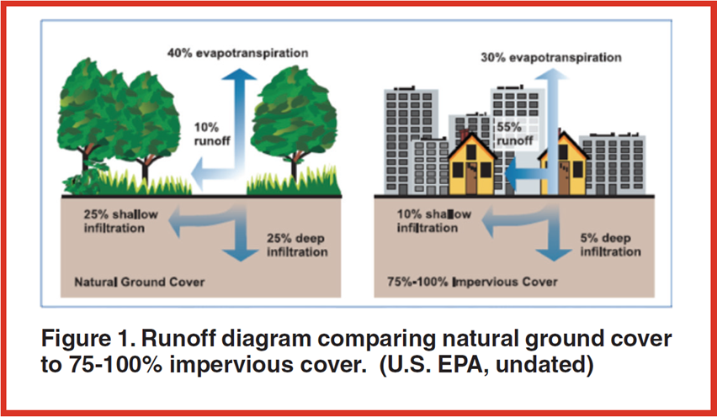
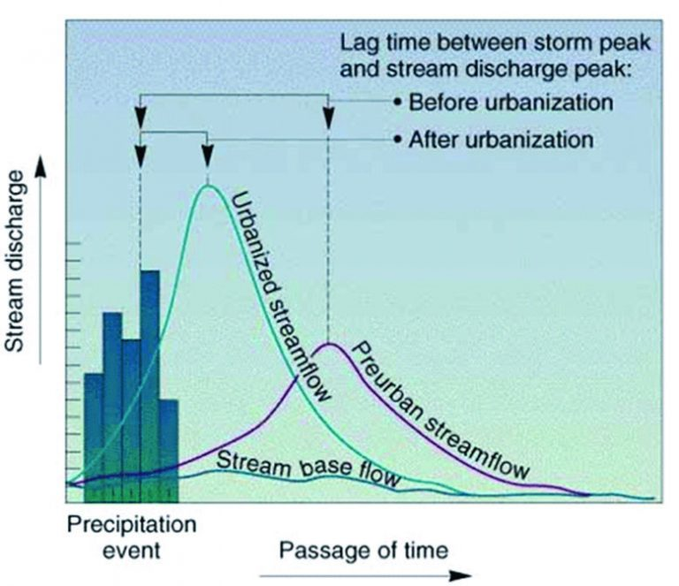
Stormwater Handling is Part of Infrastructure
Easily 5 x higher peak runoff rate
Pre-Urban Post Urban
10% runoff 55%
25% shallow infiltration 10%
25% deep infiltration 5%
50% total infiltration 15%

Slide 6
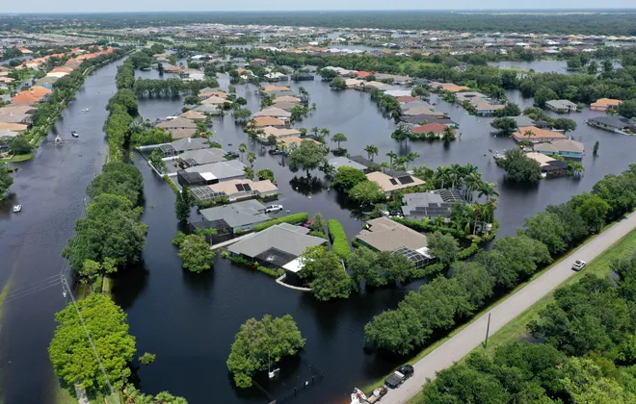
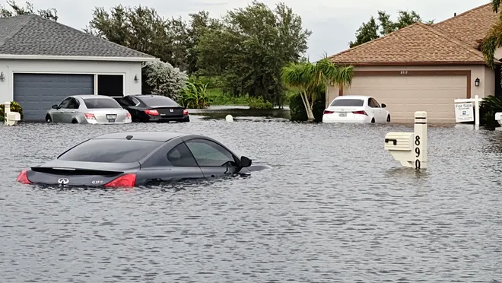
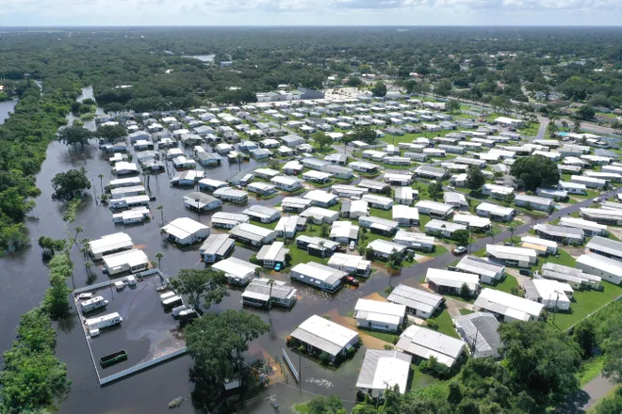
Manatee County E: 2024
September 10, 2024, the Manatee County Commission reported real estate and commercial property
damage near $56 million (Ref. Fox 13, Tampa Bay report), and
On the order of 50 million gallons of raw and partially treated sewage was released into Manatee river.

Slide 7
Manatee County Single Family Real Estate Market
The 2023 Manatee county single family real estate market value $3.81 billion
Average of almost 7,500 houses retailed at $510,000/home
The cost to rebuild about $300,000
So, the bottom line is that homeowners, recently bought a $500k house, now need to take on another $300k as an unplanned expense, placing the house 60% above market value
The really sad news is that the County is not communicating to the citizens, that this will happen over and over again, until the County decides to prioritize, fund, & upgrade the infrastructure.

Slide 8
Manatee County Infrastructure
Infrastructure is primarily funded through impact fees
Professional Civil Engineers and Urban Planners will tell you that infrastructure costs as a percent of single-family real estate, is between 10% and 50% of the home’s initial value
In 2023, the County website states that they collected $62.2 million in impact fees. That is 62.2million/3.81billion = 1.6% … i.e. grossly inadequate!
Citizens can readily verify this for example by searching ChatGPT , CoPilot or another AI sources, using the question: “what is the cost of infrastructure as a portion of single-family real estate housing”

Slide 9
Manatee County Infrastructure lag
Now, reality starts to come into focus.
Our City and County officials continues to cause a gross lag of infrastructure while accelerating sprawling single-family real estate development, and gutting impact fees giving the maximum profit to developers.
Since 2018, impact fees charged to Developers were reduced to less that 40% of what was recommended. Why!?
The answer is not that difficult to find and is outrageous!

Slide 10
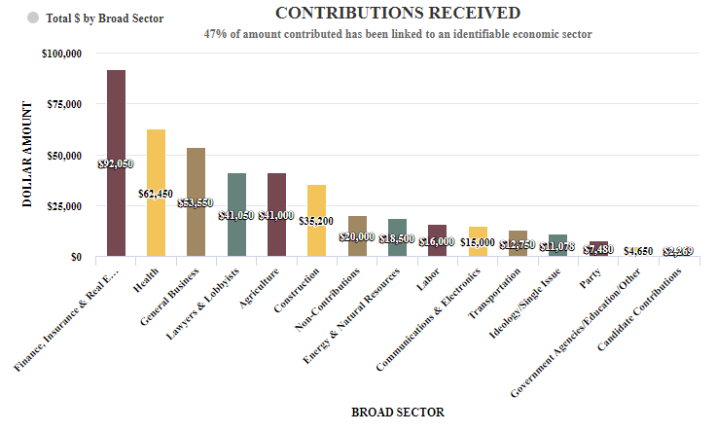
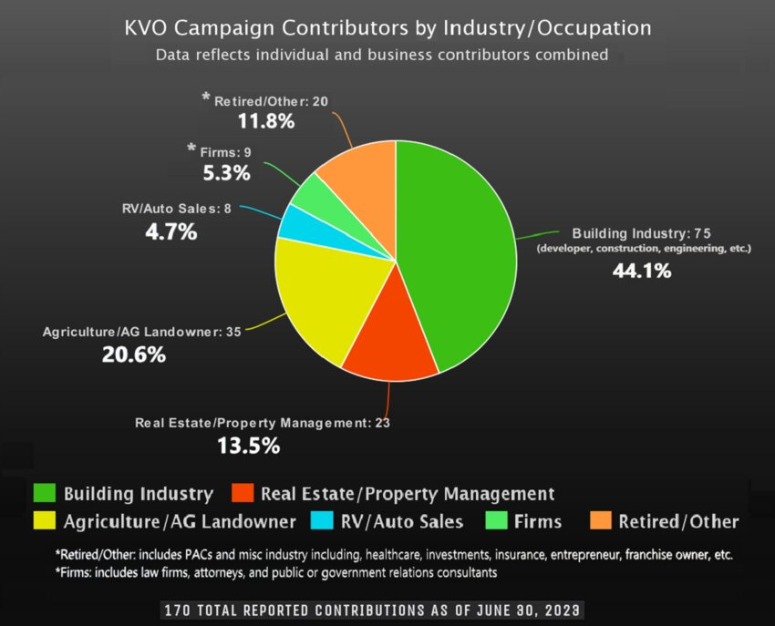
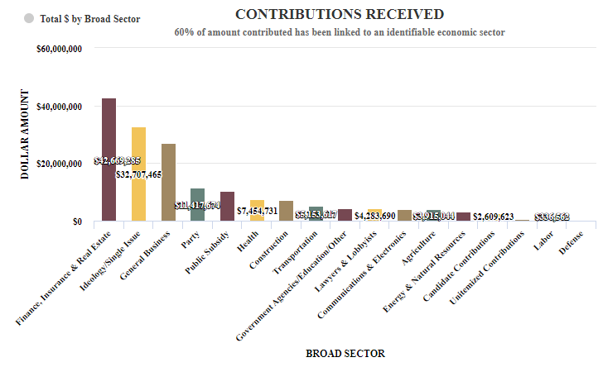
The Answer to Why!?
Campaign Funding of our officials, up and down the ballot, to name a few:
Van Ostenbridge, Will Robinson, DeSantis – More than 70% of their $100’s000 campaign funds were from real-estate and related industries (A Closer Look at Van Ostenbridge's "Record Breaking" Fundraising - The Bradenton Times, ROBINSON, WILLIAM (WILL) - FollowTheMoney.org, DESANTIS, RONALD D (RON) - FollowTheMoney.org)

Slide 11
Manatee County The Fix
The most urgent fix: A moratorium on all planned new developments to re-evaluate and adjust them to ensure adequate catch-up and new infrastructure
Appoint an independent panel of Professional Engineers and Urban planners to perform a comprehensive evaluation of the lagging infrastructure that is already baked in, as well as what to charge future developers for appropriate infrastructure
Set-up a State & local –funded properly engineered master infrastructure plan where County-wide impacts of new development can be properly evaluated
Provide State funding to catch up on lagging infrastructure so as not to over-burden existing citizens for past misconduct by this body and the State of Florida
The super-majority in Florida’s State and Local government since 1996 has clearly led to corruption. It is time to insist with legislative backing, that this disfunction be corrected by professional experts, not elected officials.

