Slide 1
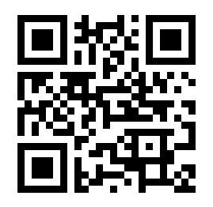
Join Adriaan DeVilliers
For a Better District 71
From City, to County, to State and Nationally,
there is much at Stake on November 5, 2024
District 71 main focus areas
Responsible Development
Health & Reproductive Rights
Democracy
Schools
Your contribution & support is vital for success!
Vote4Florida.com
Paid by Adriaan DeVilliers, Democrat, for FL District 71

